Slide 1




Slide 2

What is the point of a User-Interface in games?

Slide 3

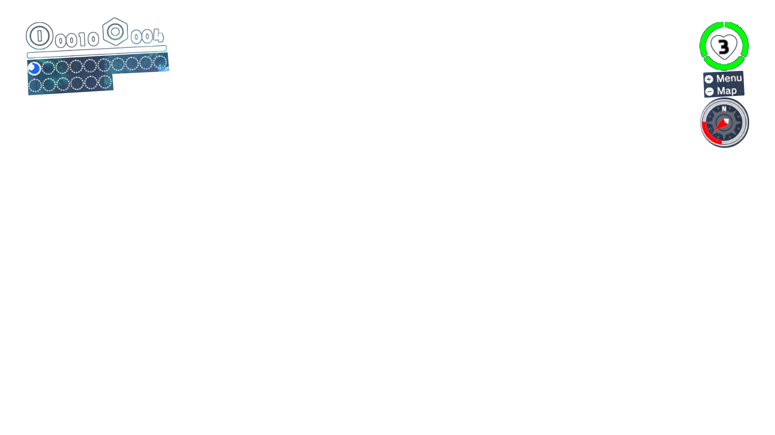
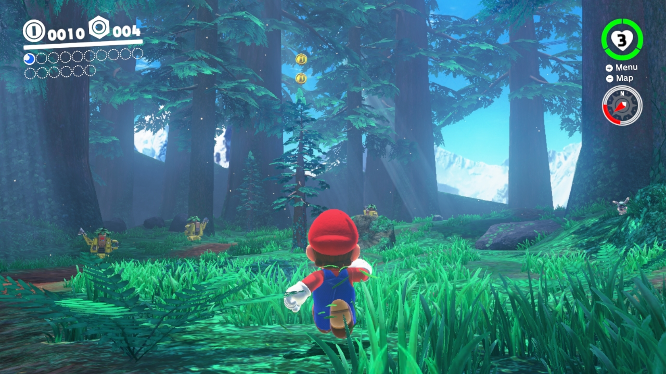
Why use UI?
Why use UI?
Display Info
BE USEFUL
Simple

Slide 4

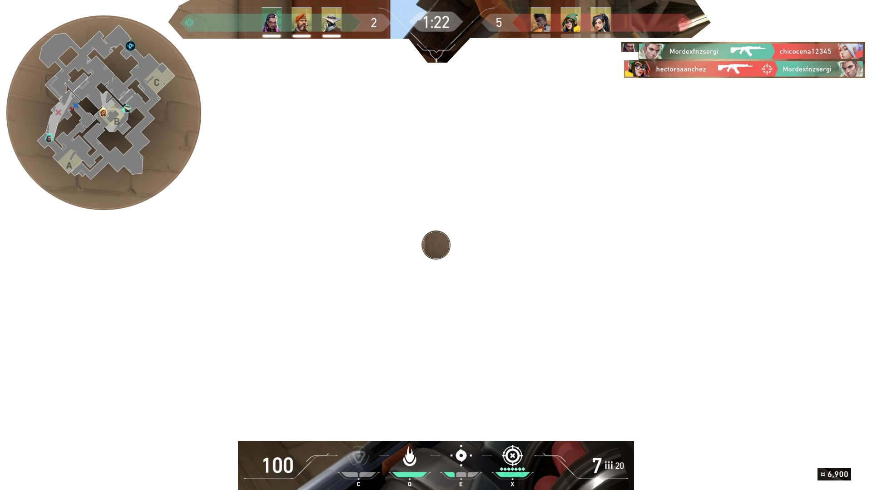
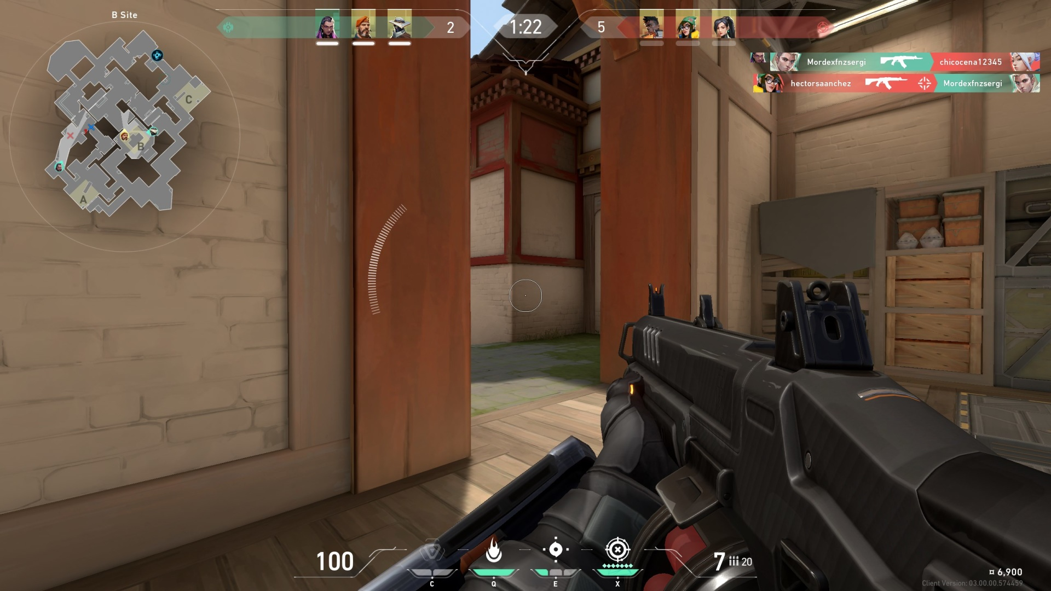
Why use UI?
Why use UI?
Display Info
Simple
Complex

Slide 5

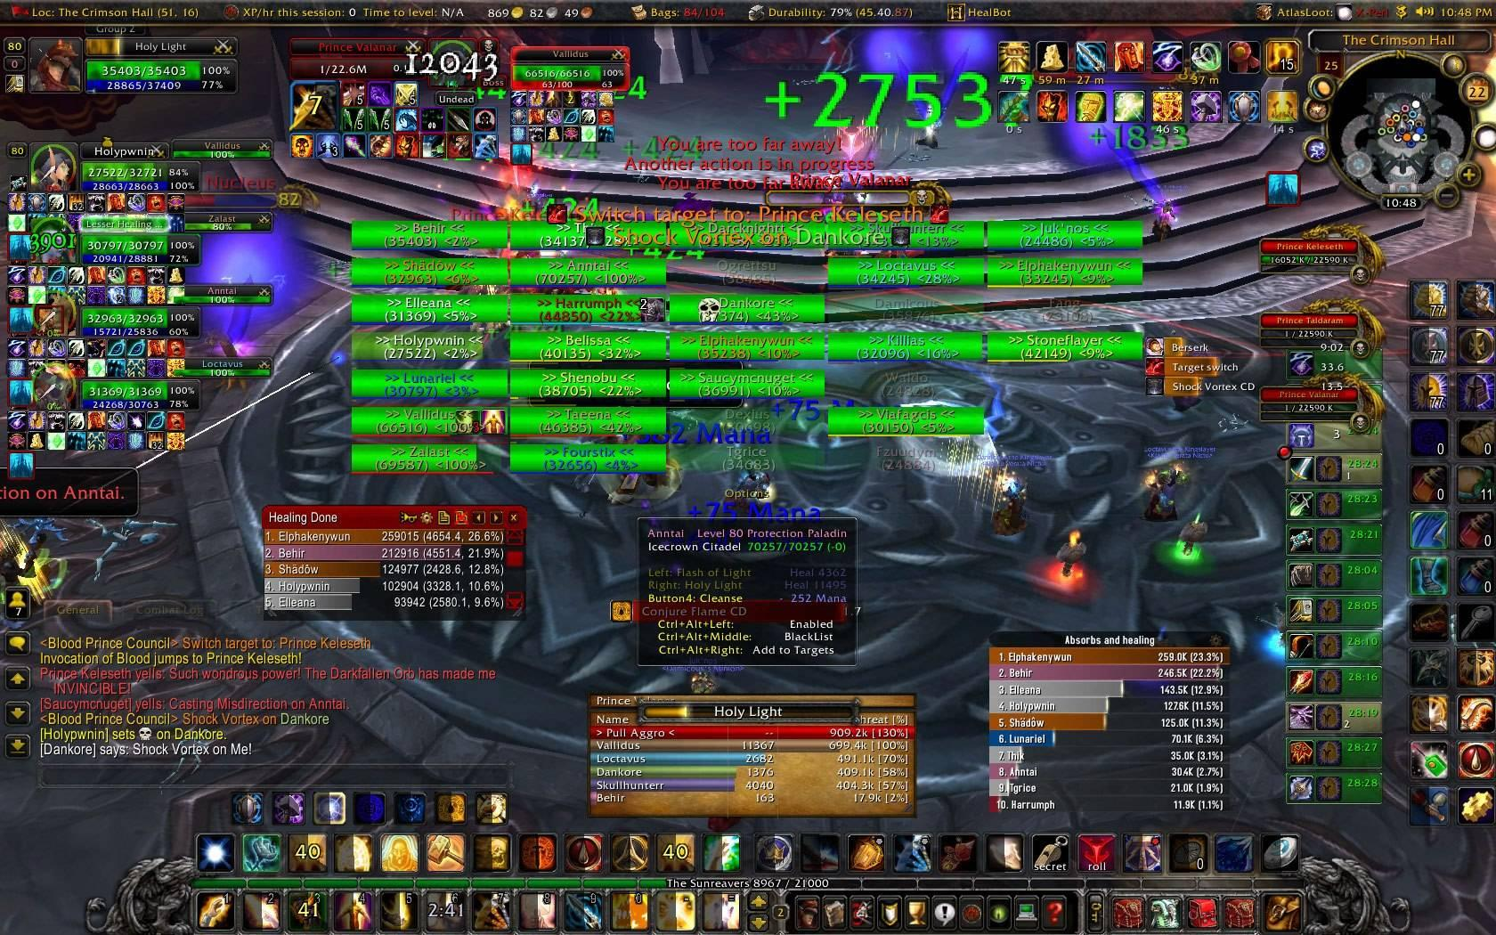
Why use UI?
Why use UI?
Display Info
Simple
Complex
ABSURD
??
?
?
??
??

Slide 6
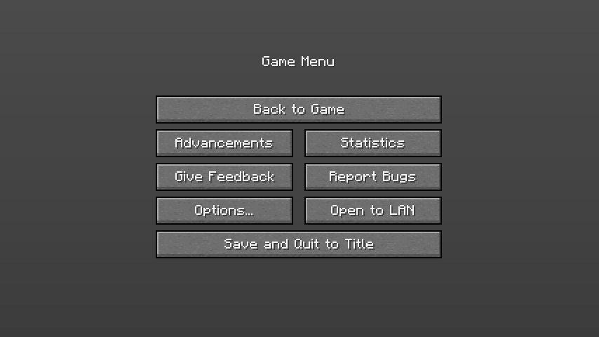
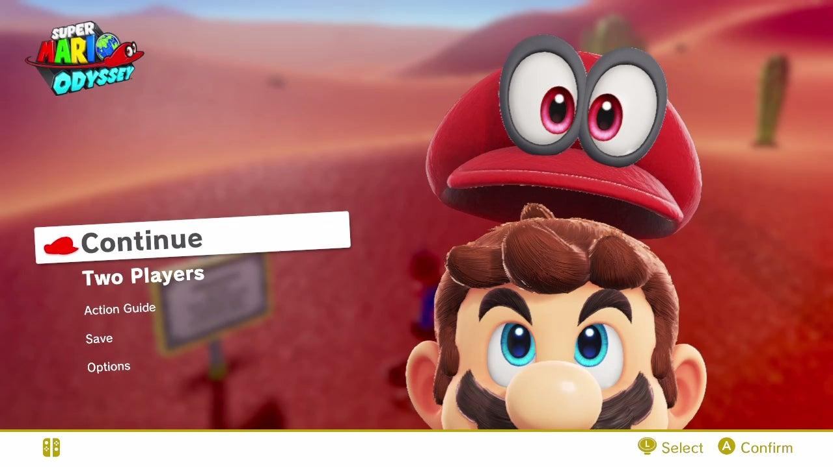
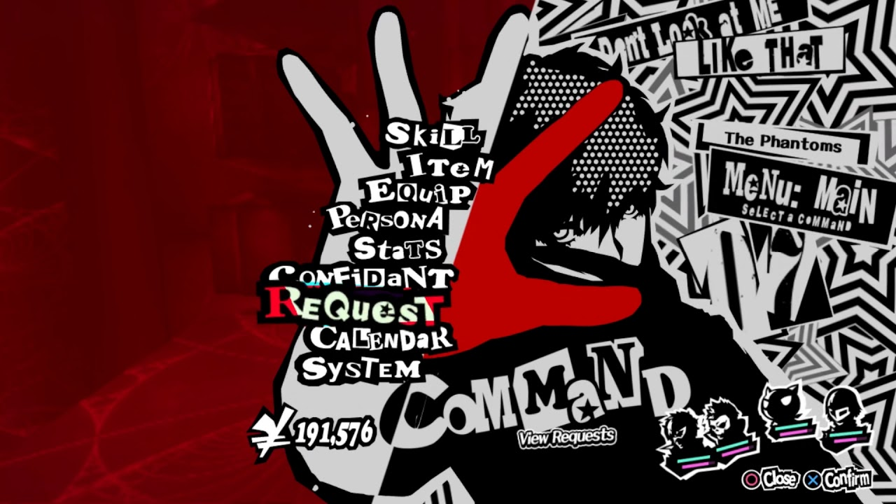
Why use UI?
Why use UI?
Display Info
Be Useful
Simple
Complex
Pause Menu

Slide 7
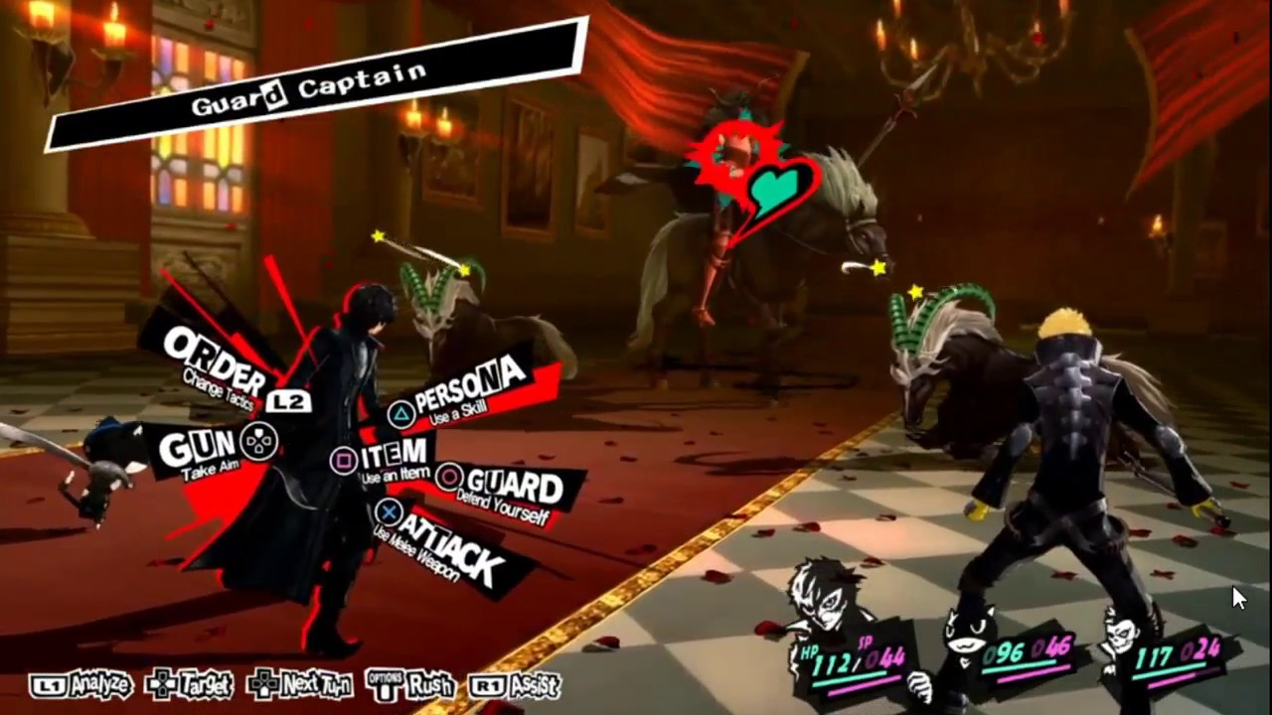
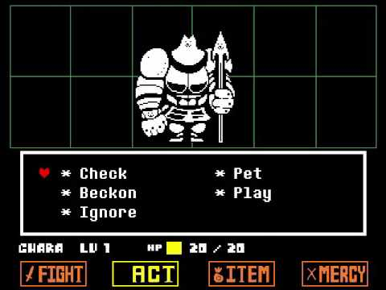
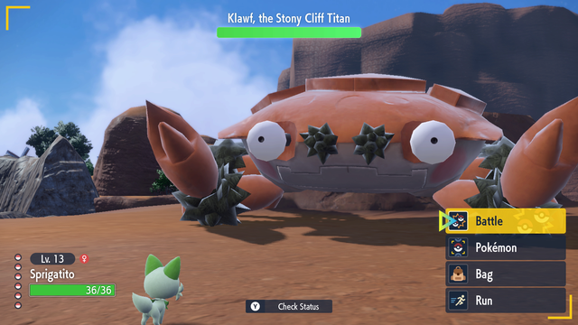
Why use UI?
Why use UI?
Display Info
Interactive
Simple
Complex
Pause Menu
Battles

Slide 8
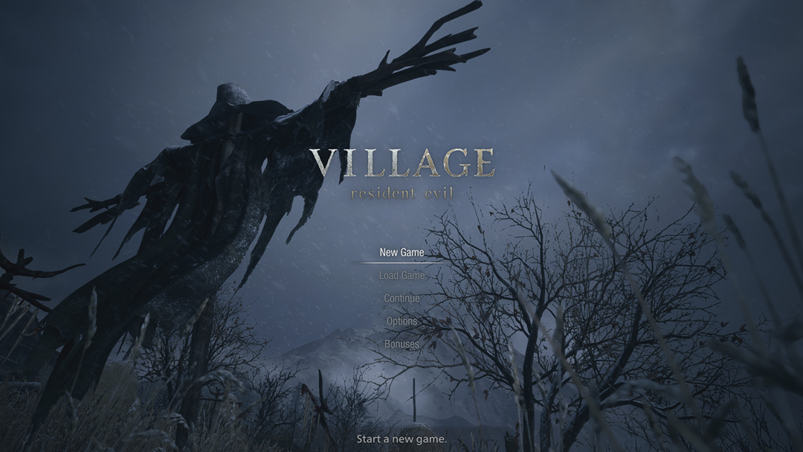
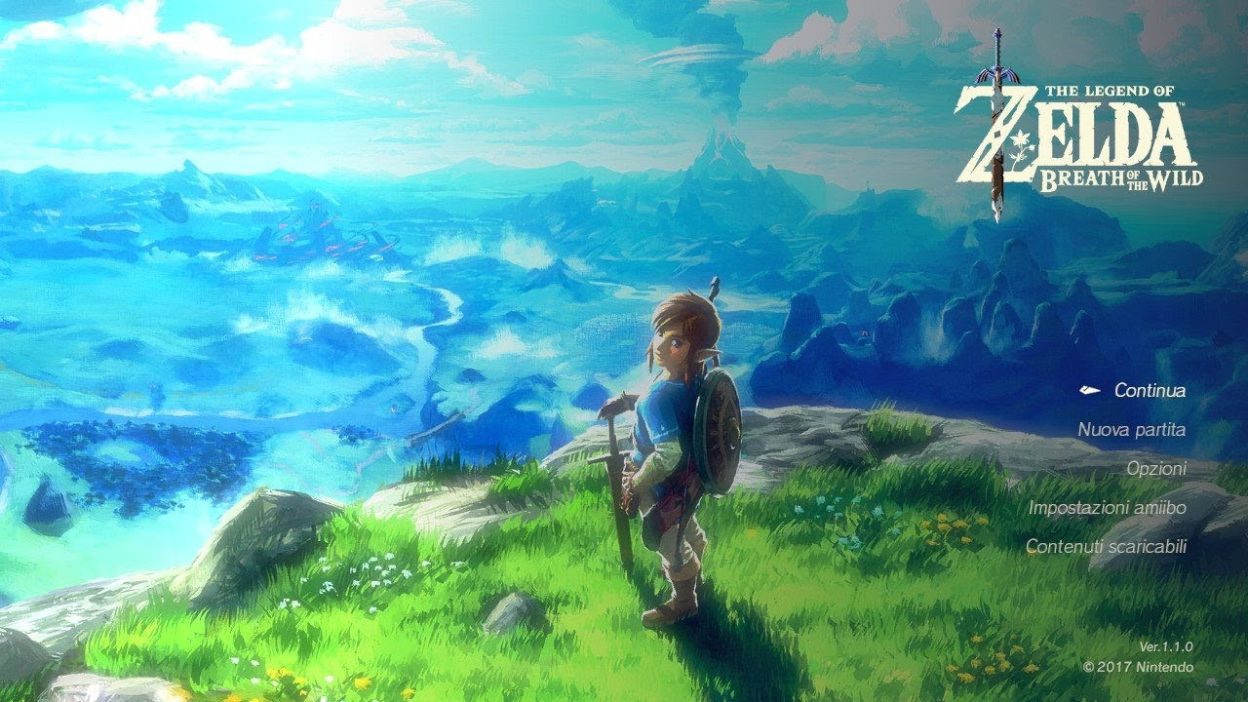
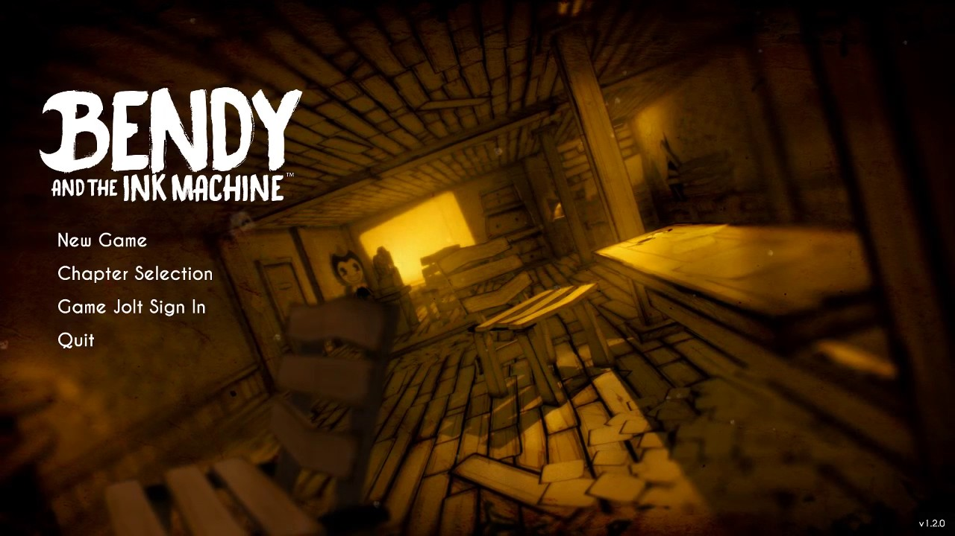
Why use UI?
Why use UI?
Display Info
Interactive
Add Style/Tone
Simple
Complex
Pause Menu
Battles

Slide 9
But for now,
Pause Menus

Slide 10
Basic Pause Menu
what you need
Resume
Settings
Vol
Restart
Main Menu

Slide 11
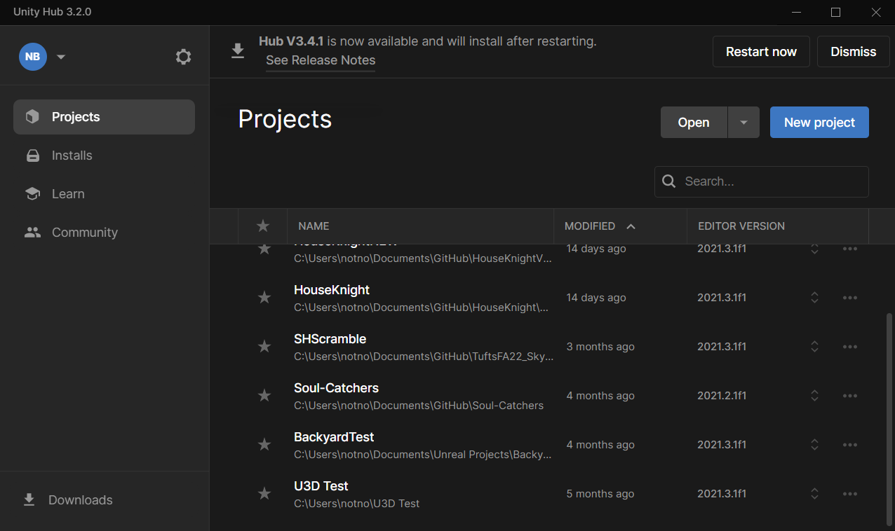
C# Scripting
Open your Unity C# Scripting (2D) project

Slide 12
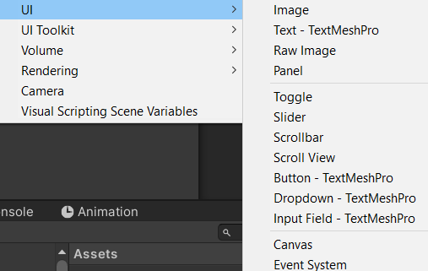
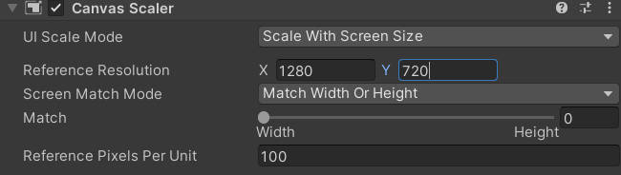
1. Set UI Scale Mode >> Scale with Screen Size
2. Create a UI Canvas

Slide 13
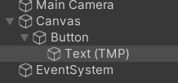
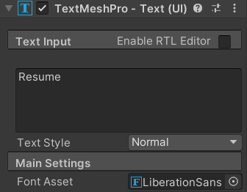
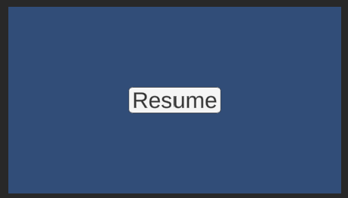
3. Create a Button (TextMeshPro)
4. Change the text under the Text (TMP) child of Button
5. You should end up with something like this!

Slide 14
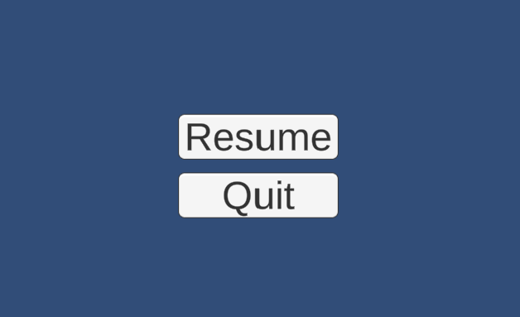
6. Duplicate this Button and move it down
7. Change the text under the Text (TMP) child of the new button to Exit

Slide 15
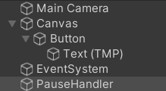
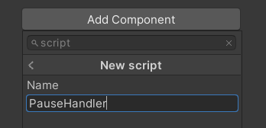
Now, we add functionality!
8. Create an Empty Game Object called PauseHandler and add a new script to it
NOTE: You can also just do this in your current GameHandler script, I personally like to separate the functions

Slide 16
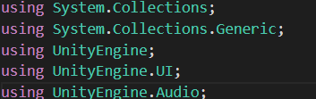
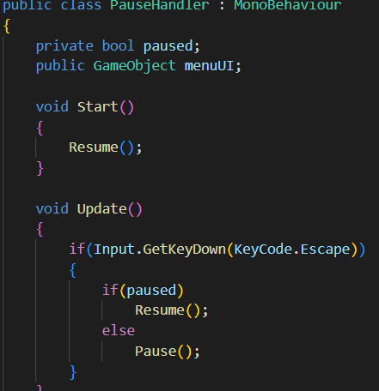
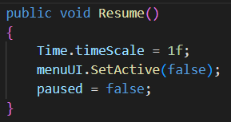
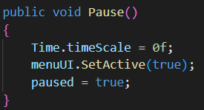
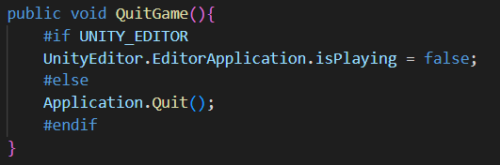
This will add the libraries necessary for UI and Audio (which we will use later)
9. Add this script to PauseHandler
What does it do?
When you push the ESC button, the UI will turn ON/OFF
It sets the timeScale to 0 when paused (which will stop the game in the background so your game doesn’t keep going when you want it stopped)
QuitGame() closes the game in itch.io AND in the gameview in Unity so you can test it

Slide 17
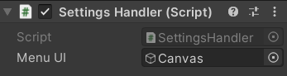
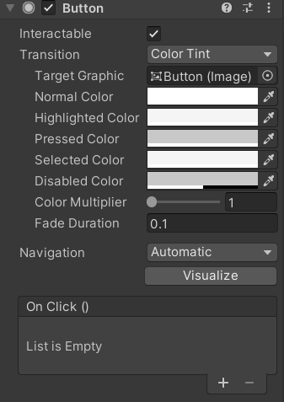
10. Drag the Canvas >> the MenuUI slot
10.5 We can customize the hover/selection properties
11. Add a new On Click event

Slide 18
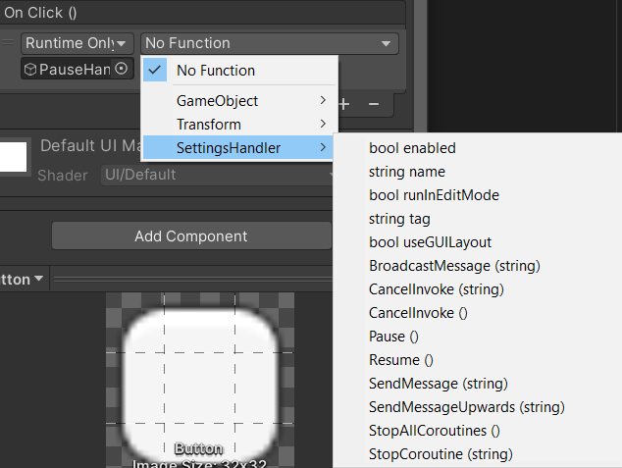
12. Drag in the PauseHandler GO (from the hierarchy) and select the PauseHandler script and Resume() function
[Pressing the ESC key will now toggle the UI on and our Resume button will turn it off]
13. We can do the same thing for the Quit Button, adding the QuitGame() function instead

Slide 19
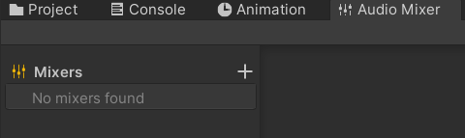
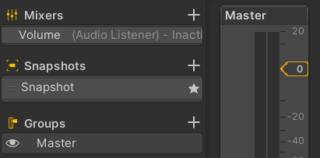
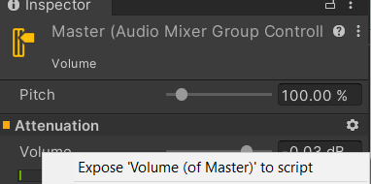
Now, let’s add a volume slider!
14. Create a new Audio Mixer (open the tab in Window >> Audio Mixer)
15. Then Expose the Volume (of Master) [by right clicking] as a parameter and change the name to “Volume”

Slide 20
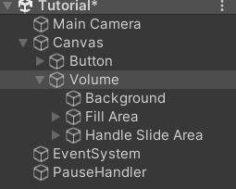
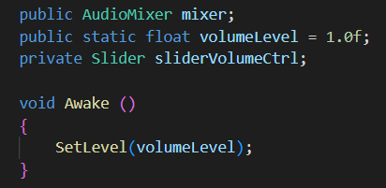
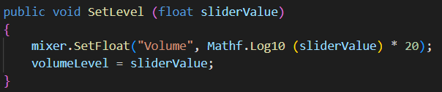
16. Then make a new UI Slider (called “Volume” in this image)
17. Add these objects and functions to your PauseHandler (SetLevel must be PUBLIC)
SetLevel will be accessed by the slider to actively update the value using the input slidervalue

Slide 21
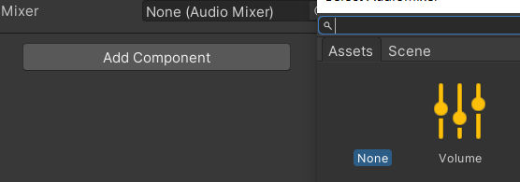
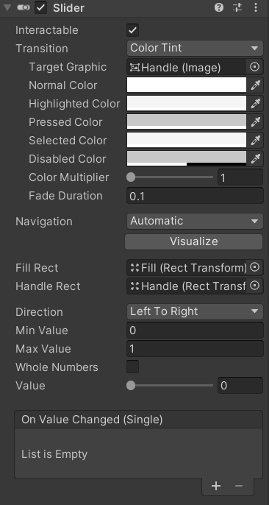
18. Select your AudioMixer in the new Mixer slot
Note: You can have different mixers grouped under master and have sliders adjust them individually (ie. SFX and Music separately)
19. Then add a new On Value Changed event under your slider and set it to the new PauseManager function SetLevel()

Slide 22
Now we make it

Slide 23
Tweening
What is Tweening?
Provides limited animation without keyframes that can be customized through CODE
Good for short procedural animations, not character movement
Some good examples would be
Door opening/closing
Moving platform
UI buttons
NOTE: Tweens do NOT work with Physics

Slide 24
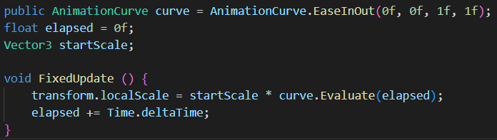
Basic Tweening
Unity has its own built-in AnimationCurve class that allows you to animate and control the speed at various points in the animation
Adding this code will call for Unity to sample a basic curve as the frames pass.

Slide 25
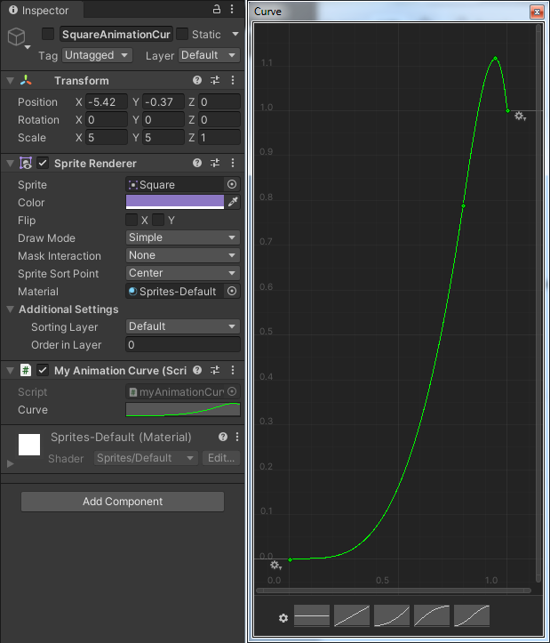
Editing the Curve
value
We will then see a velocity curve under our script that we can click on to enlarge and edit using the handles at both ends.
There are numerous presets, and think about how the movement may look as the velocity changes
This is somewhat complicated, however.
time

Slide 26

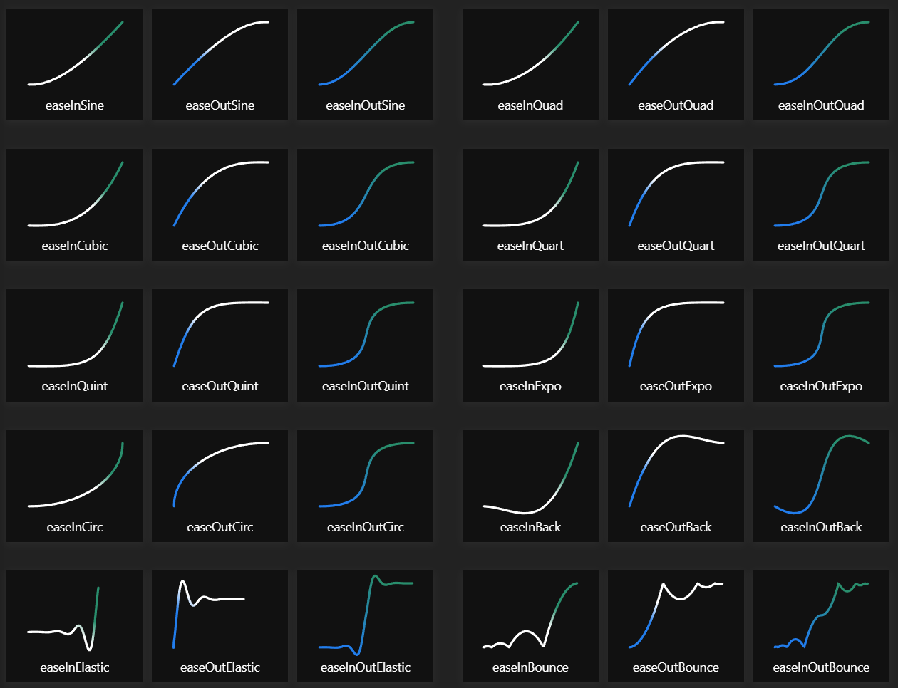
Lean Tween
Building all of those one by one takes time, and we can use a FREE library called LeanTween
LeanTween has the 30 most common animation curves and is very modular/flexible
We can see all of them on easings.net
Also fun to use https://codepen.io/jhnsnc/pen/LpVXGM to visually see the easings work

Slide 27
The format of EVERY LeanTween:
LeanTween.[property](gameObject, destination, time)
[property] is the transform you want to animate. This can be generic like scale, rotate or move or it can be set to a custom value using LeanTween.value
gameObject is the gameObject you want to affect
destination corresponds to the property you chose and its final value
ie. if you are using LeanTween.scale the result will be a Vector3 (Vector2 for 2D) whereas LeanTween.moveX will be a float
time is the time the tween takes, can be controlled via public variable

Slide 28
Adding Easing/Extensions:
LeanTween.[prop](...).setEase(LeanTweenType.EASETYPE)
.setLoopPingPong()
.setDelay(time)
.setIgnoreTimeScale(true)
*needed for all UIs since we set the timeScale to 0
setEase uses all of the types previously discussed on easings.net, just don’t forget the LeanTweenType._____ prefix before the easetype
setLoopPingPong makes the animation bounce back and forth between its start and end values (setLoopClamp will make it go back to the start like a cycle)
setDelay allows you to specify a delay for the start time which is useful for chaining multiple tweens together without a Coroutine

Slide 29
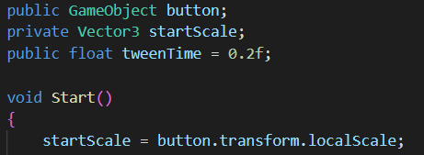
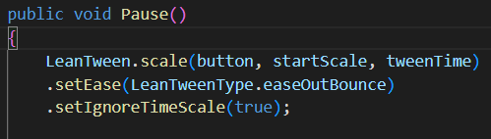
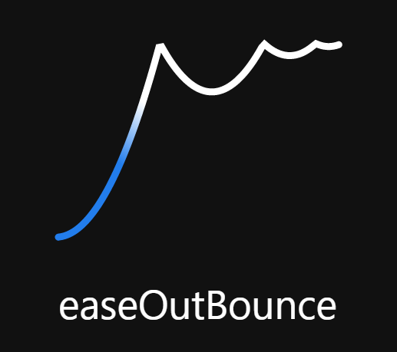
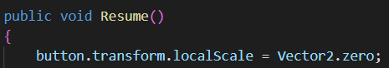
Let’s try it!
One of the most fun ones is easeOutBounce
Let’s try making our button bounce in when the UI is opened by adding this code to PauseHandler:

Slide 30
You made a simple UI!
I’ve added some other examples for inspiration, feel free to look at the scripts and try them in your own menus

Slide 31

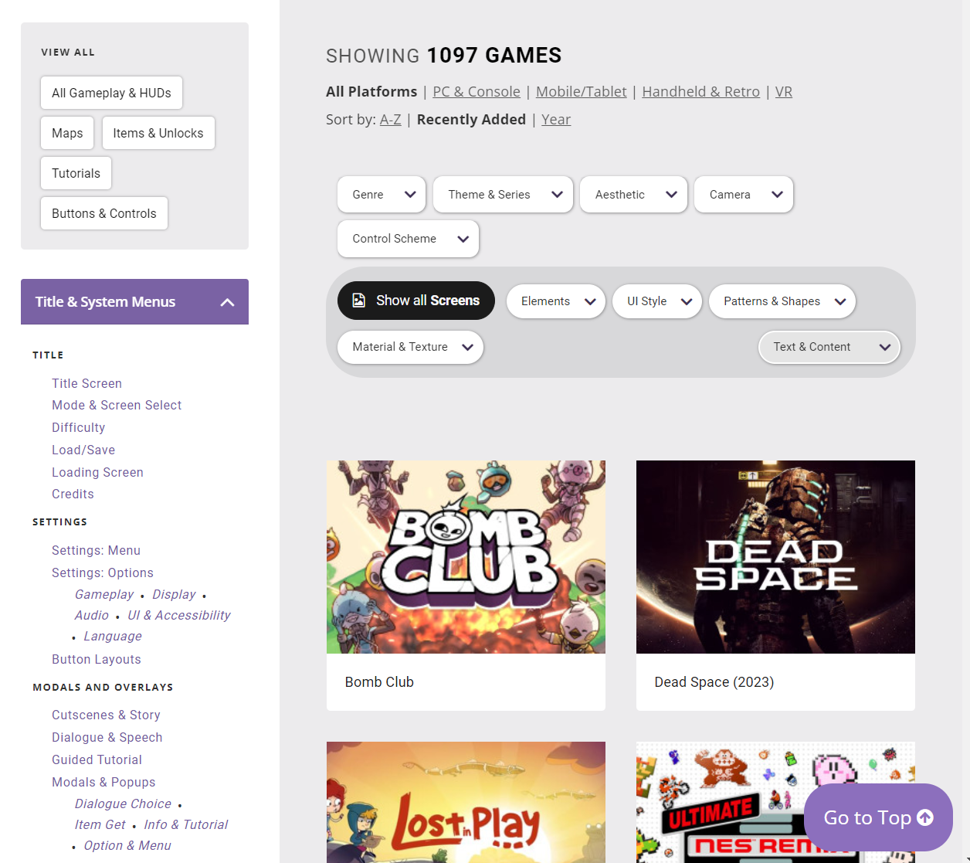
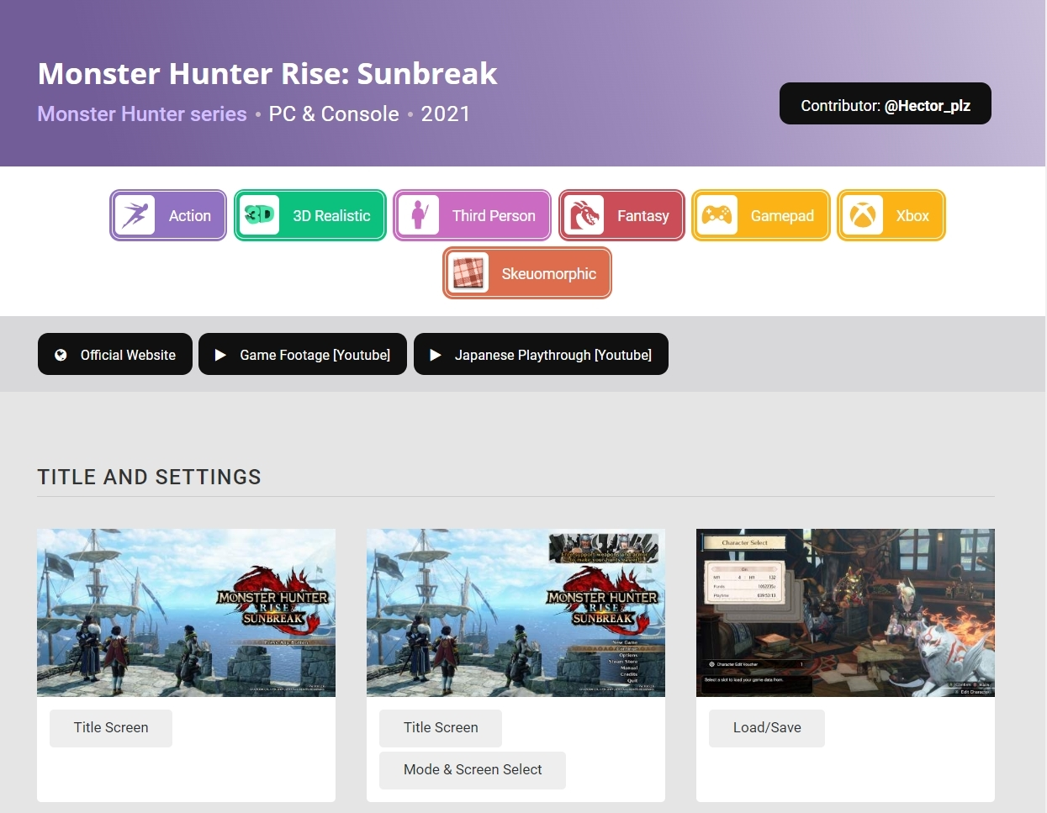
Helpful Inspiration
https://www.gameuidatabase.com/
Find UI reference from over 1000 games

